Slide 1
Data visualization
All samples available on:
http://github.com/a-vodka/dv

Slide 2
Realisation of the course
This course has been developed within the framework of the project “Mechanics digital" by the German Academic Exchange Service (DAAD) under funding program “Ukraine digital: Ensuring academic success in times of crisis (2022)" The course has been developed in collaboration with our colleagues from the Otto-von-Guericke-University Magdeburg in Germany We would like to thank the DAAD for their financial and logistical support

Slide 3
Visualizing Networks
-Can help explore data/find patterns
-But, there are multiple visual representations of the same networks
-Appearance often depends on the layout algorithm
Network = list of edges,
not the visualization itself

Slide 4
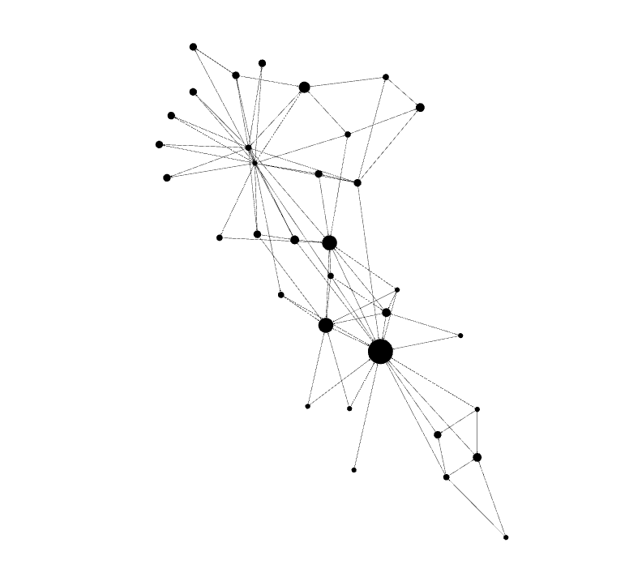
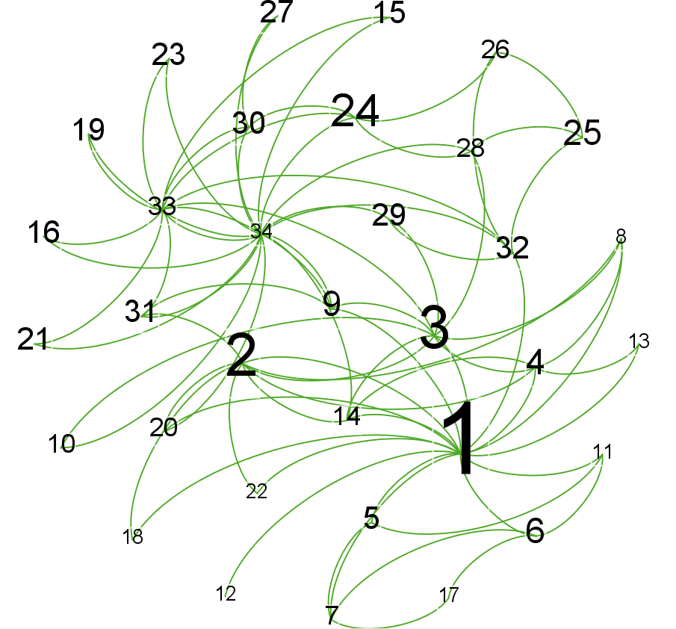
Two identical edgelists: Two different graphs (Karate Club)

Slide 5
But…graphs can still help us make sense of networks
0 | 0 | 0 | 0 | 0 | 0 | 0 | 0 | 0 | 0 | 0 | 0 | 0 | 0 | 0
1 | 0 | 0 | 0 | 0 | 0 | 0 | 0 | 0 | 0 | 0 | 0 | 0 | 0 | 0
1 | 1 | 0 | 0 | 0 | 0 | 0 | 0 | 0 | 0 | 0 | 0 | 0 | 0 | 0
1 | 1 | 1 | 0 | 0 | 0 | 0 | 0 | 0 | 0 | 0 | 0 | 0 | 0 | 0
1 | 0 | 0 | 0 | 0 | 0 | 0 | 0 | 0 | 0 | 0 | 0 | 0 | 0 | 0
1 | 0 | 0 | 0 | 0 | 0 | 0 | 0 | 0 | 0 | 0 | 0 | 0 | 0 | 0
1 | 0 | 0 | 0 | 1 | 1 | 0 | 0 | 0 | 0 | 0 | 0 | 0 | 0 | 0
1 | 1 | 1 | 1 | 0 | 0 | 0 | 0 | 0 | 0 | 0 | 0 | 0 | 0 | 0
1 | 0 | 1 | 0 | 0 | 0 | 0 | 0 | 0 | 0 | 0 | 0 | 0 | 0 | 0
0 | 0 | 1 | 0 | 0 | 0 | 0 | 0 | 0 | 0 | 0 | 0 | 0 | 0 | 0
1 | 0 | 0 | 0 | 1 | 1 | 0 | 0 | 0 | 0 | 0 | 0 | 0 | 0 | 0
1 | 0 | 0 | 0 | 0 | 0 | 0 | 0 | 0 | 0 | 0 | 0 | 0 | 0 | 0
1 | 0 | 0 | 1 | 0 | 0 | 0 | 0 | 0 | 0 | 0 | 0 | 0 | 0 | 0
1 | 1 | 1 | 1 | 0 | 0 | 0 | 0 | 0 | 0 | 0 | 0 | 0 | 0 | 0
0 | 0 | 0 | 0 | 0 | 0 | 0 | 0 | 0 | 0 | 0 | 0 | 0 | 0 | 0
0 | 0 | 0 | 0 | 0 | 0 | 0 | 0 | 0 | 0 | 0 | 0 | 0 | 0 | 0
0 | 0 | 0 | 0 | 0 | 1 | 1 | 0 | 0 | 0 | 0 | 0 | 0 | 0 | 0
1 | 1 | 0 | 0 | 0 | 0 | 0 | 0 | 0 | 0 | 0 | 0 | 0 | 0 | 0
0 | 0 | 0 | 0 | 0 | 0 | 0 | 0 | 0 | 0 | 0 | 0 | 0 | 0 | 0
1 | 1 | 0 | 0 | 0 | 0 | 0 | 0 | 0 | 0 | 0 | 0 | 0 | 0 | 0
0 | 0 | 0 | 0 | 0 | 0 | 0 | 0 | 0 | 0 | 0 | 0 | 0 | 0 | 0
1 | 1 | 0 | 0 | 0 | 0 | 0 | 0 | 0 | 0 | 0 | 0 | 0 | 0 | 0
0 | 0 | 0 | 0 | 0 | 0 | 0 | 0 | 0 | 0 | 0 | 0 | 0 | 0 | 0
0 | 0 | 0 | 0 | 0 | 0 | 0 | 0 | 0 | 0 | 0 | 0 | 0 | 0 | 0
0 | 0 | 0 | 0 | 0 | 0 | 0 | 0 | 0 | 0 | 0 | 0 | 0 | 0 | 0
0 | 0 | 0 | 0 | 0 | 0 | 0 | 0 | 0 | 0 | 0 | 0 | 0 | 0 | 0
0 | 0 | 0 | 0 | 0 | 0 | 0 | 0 | 0 | 0 | 0 | 0 | 0 | 0 | 0
0 | 0 | 1 | 0 | 0 | 0 | 0 | 0 | 0 | 0 | 0 | 0 | 0 | 0 | 0
0 | 0 | 1 | 0 | 0 | 0 | 0 | 0 | 0 | 0 | 0 | 0 | 0 | 0 | 0
0 | 0 | 0 | 0 | 0 | 0 | 0 | 0 | 0 | 0 | 0 | 0 | 0 | 0 | 0
0 | 1 | 0 | 0 | 0 | 0 | 0 | 0 | 1 | 0 | 0 | 0 | 0 | 0 | 0
1 | 0 | 0 | 0 | 0 | 0 | 0 | 0 | 0 | 0 | 0 | 0 | 0 | 0 | 0
0 | 0 | 1 | 0 | 0 | 0 | 0 | 0 | 1 | 0 | 0 | 0 | 0 | 0 | 1
0 | 0 | 0 | 0 | 0 | 0 | 0 | 0 | 1 | 1 | 0 | 0 | 0 | 1 | 1
← Matrix of 15 out of the 34 nodes from the Karate Club

Slide 6
How should I visualize a graph then?
Consider: What do you want to emphasize?
Global (Whole network) factors
i.e. Notice how sparse the entire network is
Positional factors
i.e. Notice these individual nodes with high degree centrality
Local factors
i.e. Notice these groups or cliques of nodes

Slide 7
Two identical edgelists: Two different graphs (Karate Club)

Slide 8
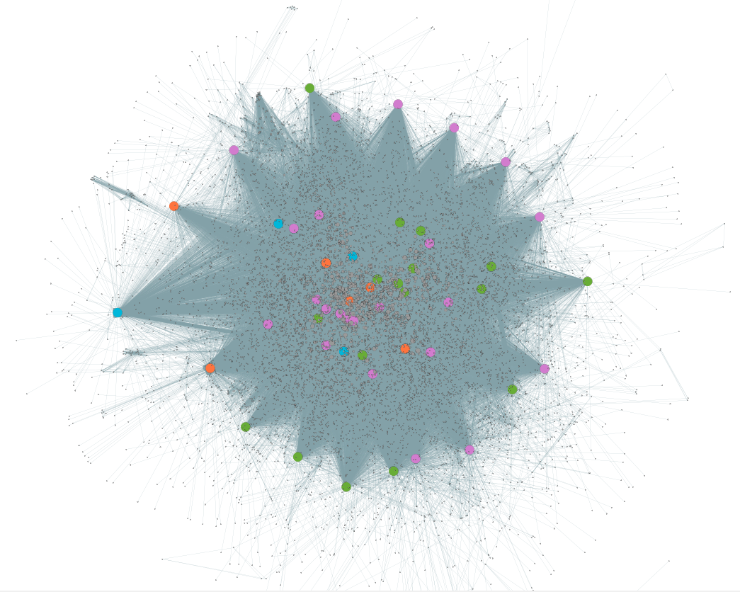
Global measures – Marvel network
What do you notice about the entire network?

Slide 9
Global measures – Marvel network
What do you notice about the entire network?
N = 10,448(!)
-”hairball”
-Fairly tightly connected with some outliers

Slide 10
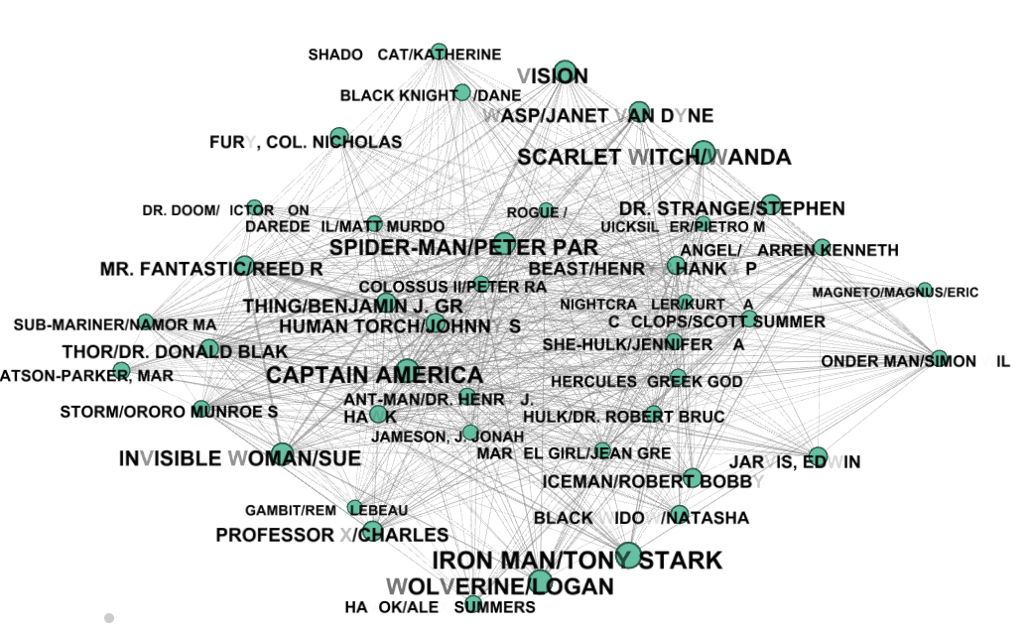
Positional measures – Marvel network (top 43 degree central)
What do you notice about the individual nodes?
Who’s the most central?

Slide 11
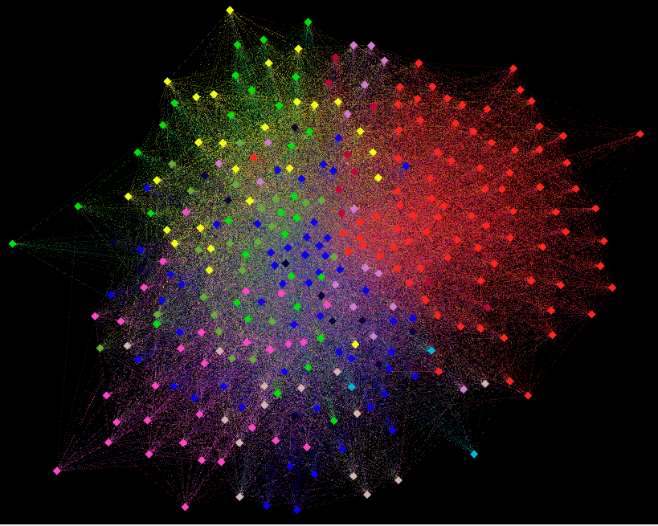
Local measures – Marvel network (N =top 300)
What do you notice about the groups within the network?
Are there clusters? Communities?

Slide 12
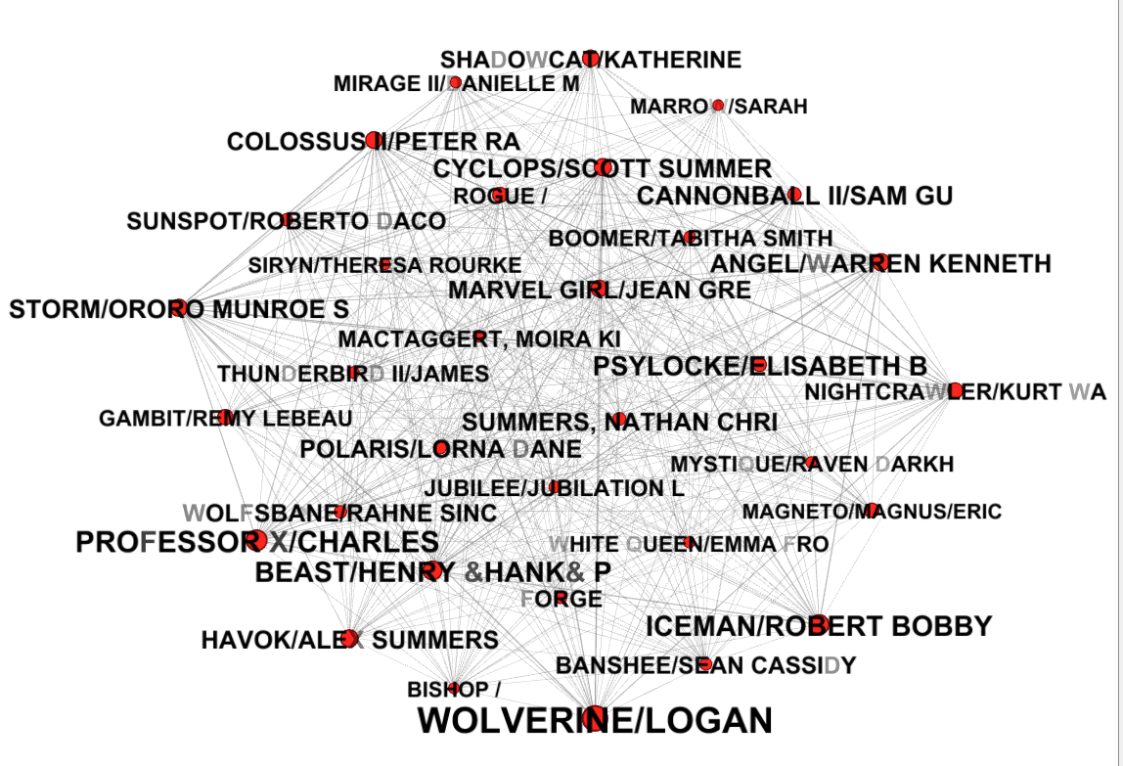
Taking a closer look at one community (with the highest degrees)

Slide 13
Other Network Metrics (will be discussed in future classes)
Network-wide global measures
- Centralization, density, degree distribution
Positional measures
-Centrality (degree, betweenness, eigenvector)
Local measures
- Clustering, communities, transitivity

Slide 14
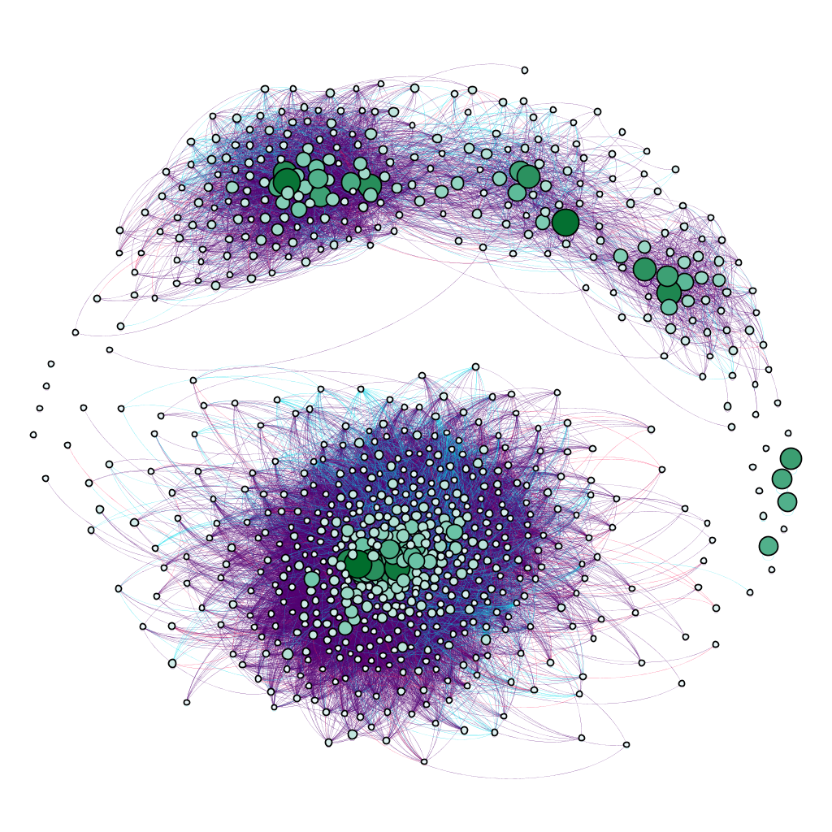
Getting Started in Gephi

Slide 15
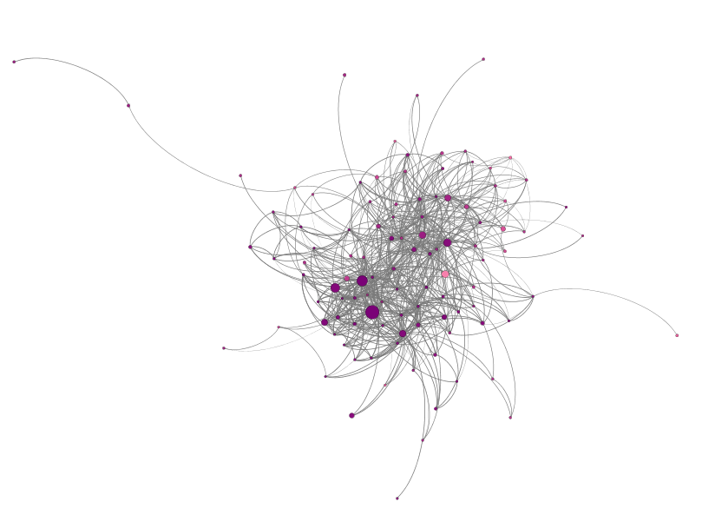
Overview
G.U.I. overview
Importing files
Nodal and edge attributes
Visualization
Filtering
Ranking
Partitioning
Labels
Layouts
Exporting

Slide 16
Importing Files
Import me into Gephi first!
2 .csv files
1 Nodelist
Id
Label
Nodal Attributes

Slide 17
Nodal Attributes
Labels
Name of person/group
Demographics
Sex, age
Group membership or role
Students of UC Davis vs Sac State
Student vs. Professor
Network stats
Centrality (In-degree, out-degree, degree, etc.)

Slide 18
Importing Files
Import me into Gephi first!
2 .csv files
1 Nodelist
Id
Label
Nodal Attributes
*These have to be labeled as such
1 Edgelist
Source*
Target*
Type (undirected, directed)
Label
Weight
Edge attributes

Slide 19
Edge Attributes
Weight
frequency, # of instances of communication
Rank
Rate your strength of relationship between…
Multiplexity
Type of relation
Friend, Mentor, Relative
Time of tie (longitudinal networks)
Network properties depending on the rest of the graph

Slide 20
Types of Attribute inputs
String – text fields
Integer – Categorical numerical data
Float – Continuous attributes
Note: These are some of the basics
→ there are many others

Slide 21
Filtering
Degree Range – In-degree or Out-degree or degree
Remove Isolates or pendants
Edge Weight
Why filter?
Large graphs – can be unreadable
Only interested in part of the graph

Slide 22
Ranking – adjust node’s or edge’s color/size
Size
Color
Centrality – Degree, Eigenvector, closeness
Other Nodal/edge Attributes (i.e. age)

Slide 23
Partition – separate nodes into groups by colors
Can separate in terms of belonging to specific groups
Gender
Age
Occupation

Slide 24
Labeling – names individual nodes
Used for every node in relatively small network graphs (2 – 50ish people)
Larger networks often just label key actors (if that is a focus)

Slide 25
Layouts – the shape of the graph
Most are force-based algorithms
Linked → attracted
Not linked → repelled
Each has Layout Properties
Control aspects of the algorithm

Slide 26
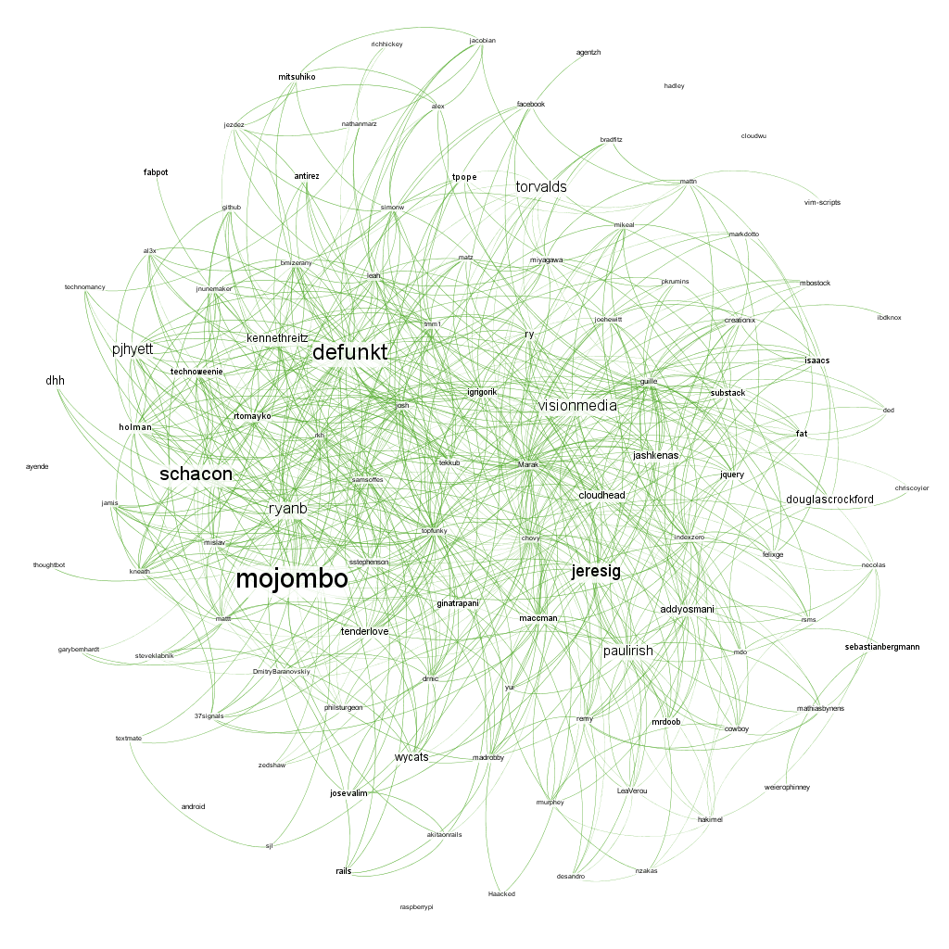
Ex. layout – Frutcherman-Reingold
Each node is the same distance apart
Slow, but readable
1 to 1000 nodes
Force-directed

Slide 27
Ex. Yifan Hu
Fast, good for large graphs
100-100,000 nodes
Force-directed

Slide 28
Adjusting layout graphics
Is your graph out of the picture or are the nodes too close?
-First re-center (click magnifier glass)
If nodes are still too close:
-Use Expansion under layout tab
If nodes are still too far
-Use Contraction
If the labels are still on top of each other
-Use Label Adjust

Slide 29
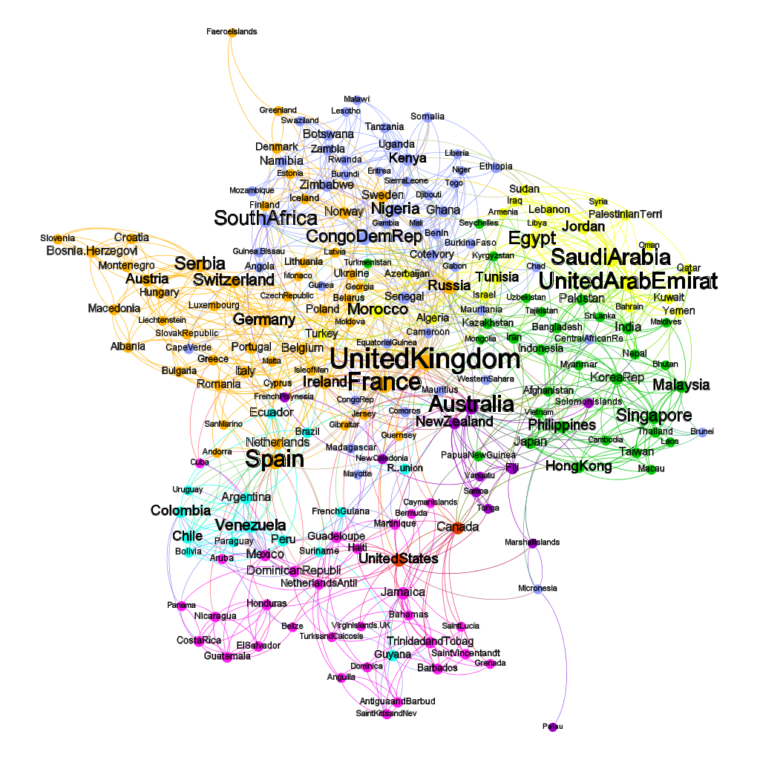
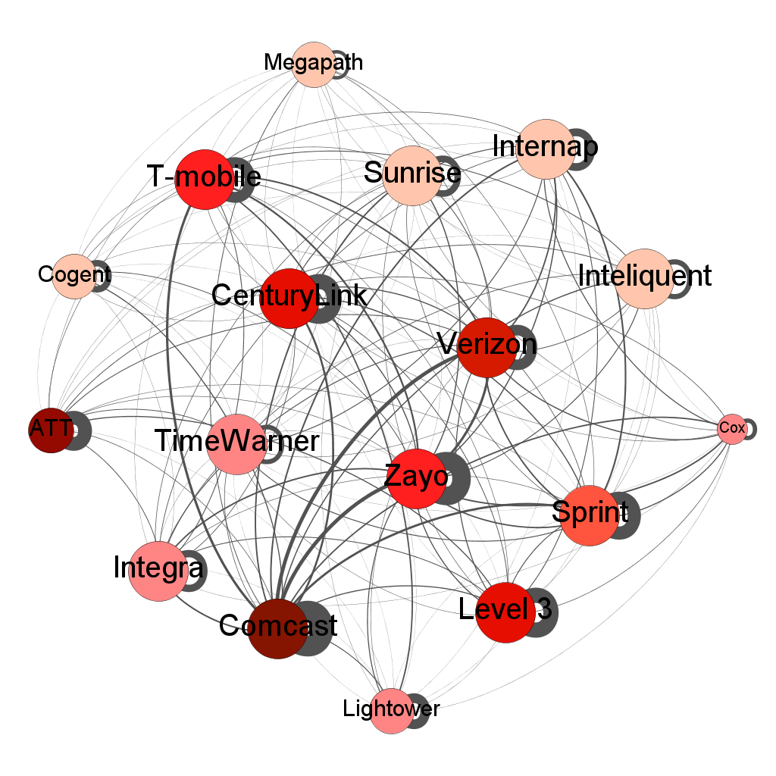
Other graph examples
Barnett, G.A., & Benefield, G.A. (in press). Predicting international Facebook ties
through cultural homophily and other factors. New Media & Society.
Benefield, G.A. (2015, May). Who Controls the Internet? Internet Service Providers and their interdependent directors. Paper presented at the annual convention of the International Communication Association, San Juan, Puerto Rico.

Slide 30
Preview
*This is where you can export high quality images of your graph (instead of a screenshot)
Note that the graph often looks different in preview tab
You can make adjustments here before exporting
Note: Preview tab can also be useful in helping you with preset graphs—so you can spend less time in the Graph tab

Slide 31
Exporting
Go to File→ Export→Graph
Can export as a .pdf file
You can also export the matrix (not the graph) in a .csv file

Slide 32
Stuck?
Go to the Gephi Tutorials on their website
Use this cheat sheet to help you out: http://www.clementlevallois.net/gephi/tuto/en/gephi_cheat%20sheets_en.pdf

Slide 33
Social Network Analysis (SNA) with Gephi
https://gephi.org

Slide 34
What is Social Network Analysis
Contribution of network analysis to online communities
Social Network Analysis with Gephi
What is Gephi
Gephi Interface
Using Gephi on facebook social network
Where we can also use Gephi

Slide 35
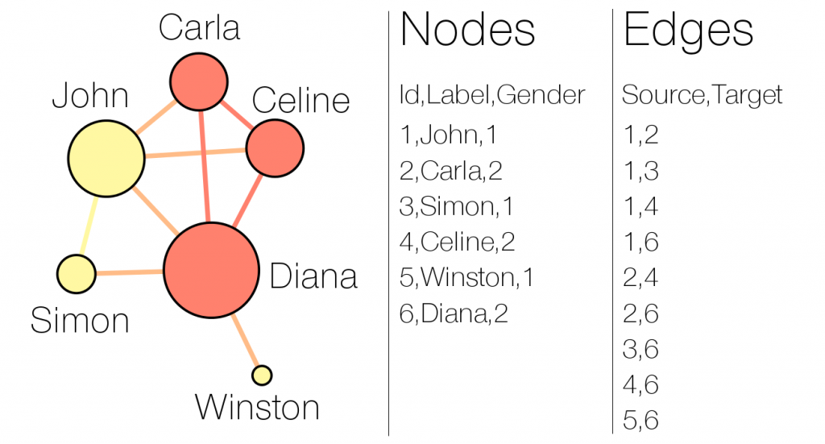
What is Social Network Analysis
Social network analysis (SNA) is a mathematical or computer science theory which consist to visualized and modeled the individuals of a network and the relationships between these individuals keep on through algorithms and statistics to glimpse a number information according to the user need.

Slide 36
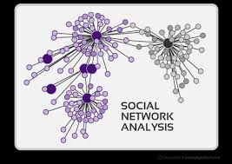
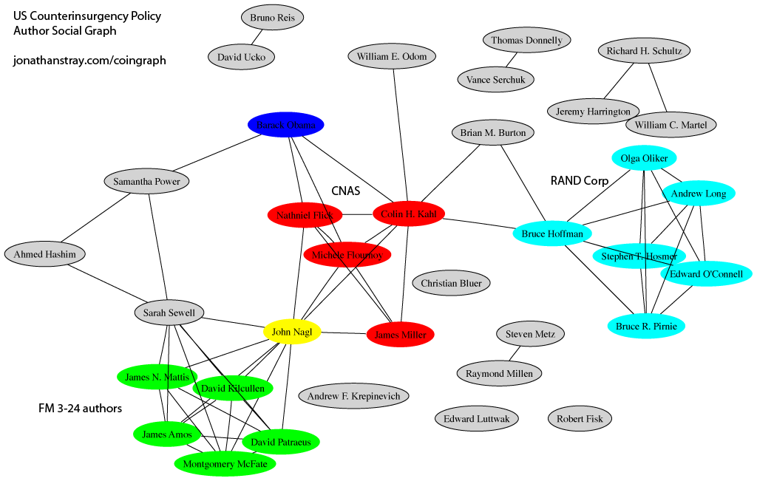
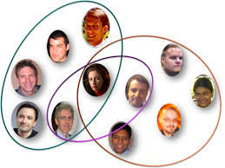
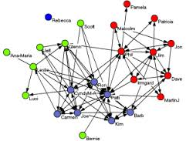
Examples of Social Network Analysis

Slide 37
Contribution of network analysis to online communities
Identify the group creators
Identify opinion leaders
Identify key accounts of a network
Identify information consumers in a network
Identify the main distributors of information in the network
Identify the different groups of people or concepts in a network
Follow the dissemination of a message
Determine the dominant genre of a network
Multimember ship identify an individual
Identify individuals keep having the most or the relationships in a network
Identify the network of an individual
Communities detections
...

Slide 38
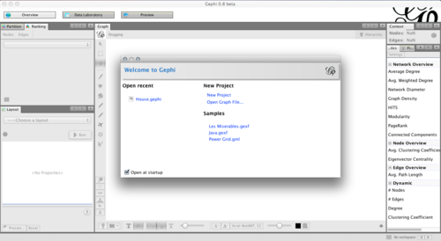
Social Network Analysis with Gephi
What is Gephi
Created in 2008 by a team of four software engineers; usable on Mac, Windows and Linux; Gephi is a software for viewing, analysis and data mining as graphs of any type.
The objective is to facilitate the analysis of data in the generation of hypotheses, intuitive discovery of patterns, isolation of singularities or detection of errors related to the capture of data.

Slide 39
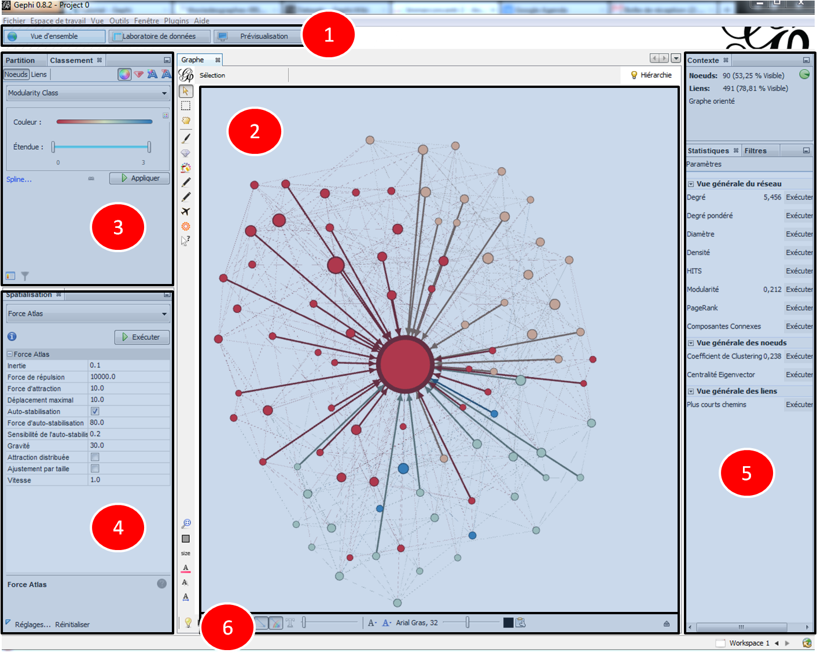
Gephi interface

Slide 40
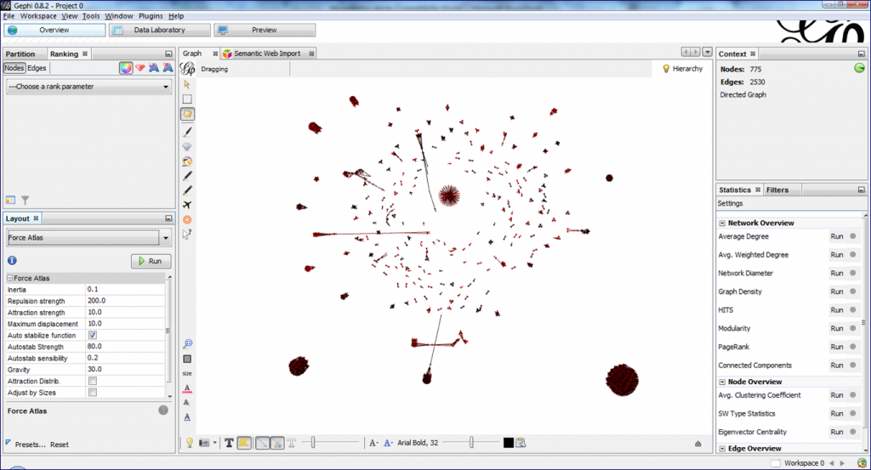
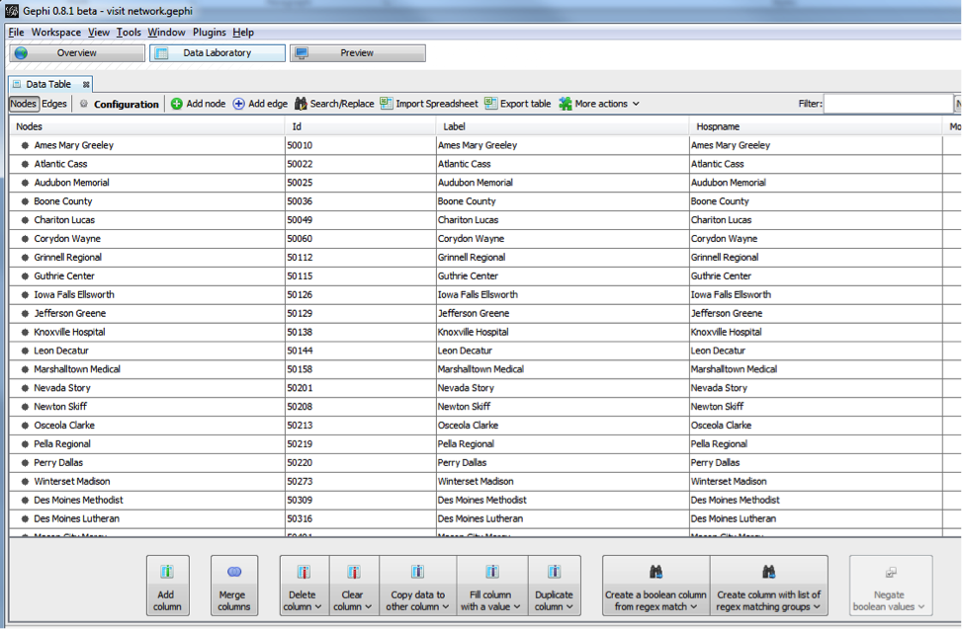
1) The change of view or taskbar: This is an area to move from one tab to another.
Overview to analyze information: gives access to general software features and work in real time. (access points 2, 3, 4, 5, 6)
Data Laboratory to access de data manipuled as in excel: Allows to see or modified if necessary some parameters to the needs of the users.

Slide 41
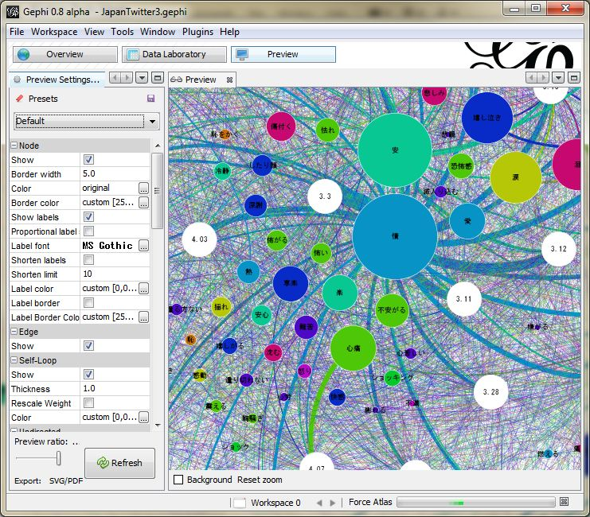
2) The central area: It allows you to view a real-time overview of the current job or work done. 3) The area classification and partition: To color data based on parameters obtained by statistical analysis, or separate data to apply different colors.
Preview to get a final result: allows to fine-tune the visualization and generate a beautiful image

Slide 42
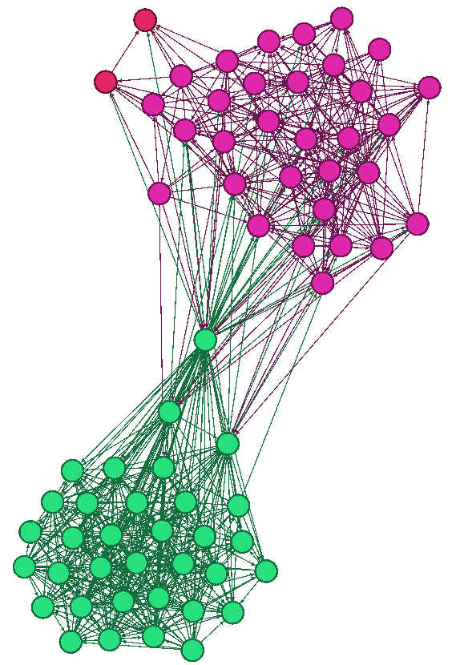
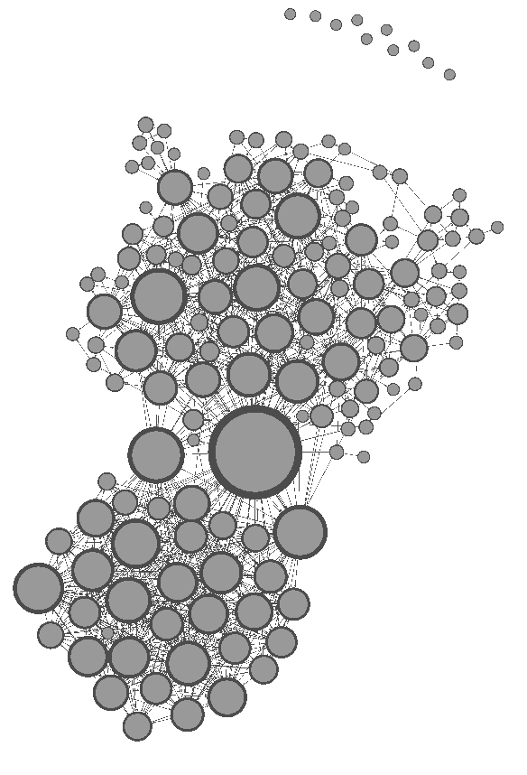
The coloring of nodes according to some statistical parameters
coloring of nodes based on different communities involved in a group of my facebook network.
Changing the size of the nodes based on some statistical parameters
changing the size of the nodes according to the degrees

Slide 43
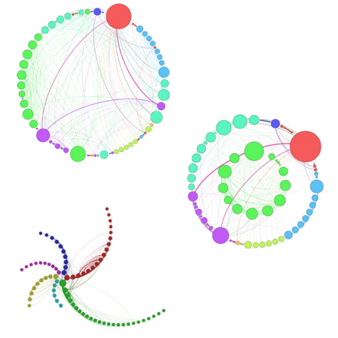
4) spatial zone: Zone where chooses the necessary algorithms (plugins) to better view the information. Concretely there are 4 types of algorithms as needed:
Ranking algorithms
Circular layout
Radial Axis layout

Slide 44
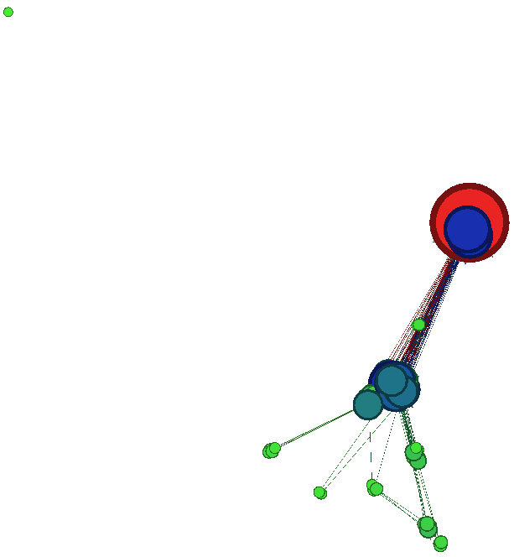
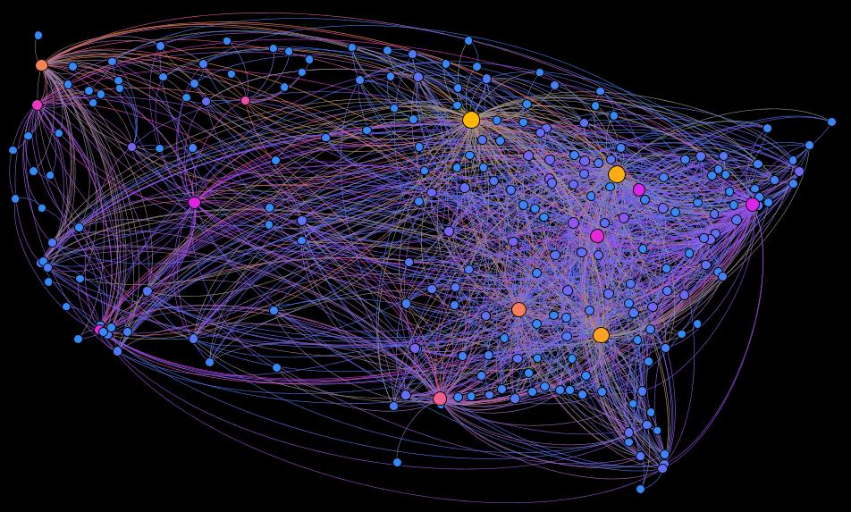
Algorithms divisions
OpenOrd
Algorithms geographic distributions
GeoLayout

Slide 45
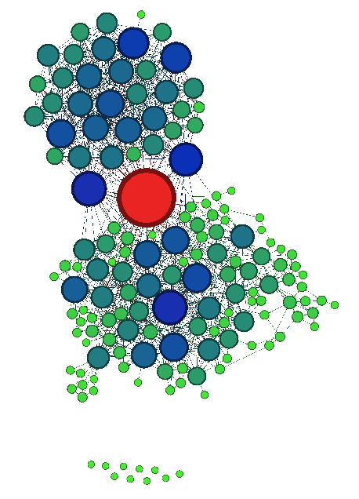
Complementarities algorithms
Force Atlas
Force Atlas 2
Force Atlas 3D
Yifan Hu
Frushterman
…..
We also have:
• Adjustment of labels / noverlap: Avoid the names overlap on your network
• Contraction / expansion: Increases or decreases the space between the nodes

Slide 46
5) Filter tab and statistic
With this tool, we can remove some nodes of our network, filter information based on certain parameters, but also perform statistical analyzes.
Statistics tab
The parameters that we can have are:
Degree: calculate the number of links has a node
Degree weighted: calculates the average number of links can have a node.
(They refer Degree Distribution, In-Degree Distribution, Out-Degree Distribution)
Diameter : is the longest distance between two network nodes.
It returns:
Betweenness centrality: which measures the frequency of occurrence of a node on the shortest paths between network nodes
Closeness centrality: measures the average distance between a node and all other nodes.
Eccentricity: measuring the distance of a node relative to the most distant node from it.

Slide 47
Density : determines the percentage of network complementarity. Modularity : identifying groupings to highlight the communities in a network Eigenvector centrality: measures the importance of a node in the network according to its connections Related Components: determines the number of connected components in the network HITS Page Rank related components: determine the number of connected components in the network.

Slide 48
Filter The data can be filtered according to several domains (network attributes, network topology, network operators in the (Union, Intersection, ...), the dynamics of the network, the network links or even already saved queries ). These attributes using all statistical parameters seen above.
6) The data display
This tab allows you to vary the size of the nodes, links between nodes, and display the name of the nodes.
It manages the readability of the network according to the need of the user.

Slide 49
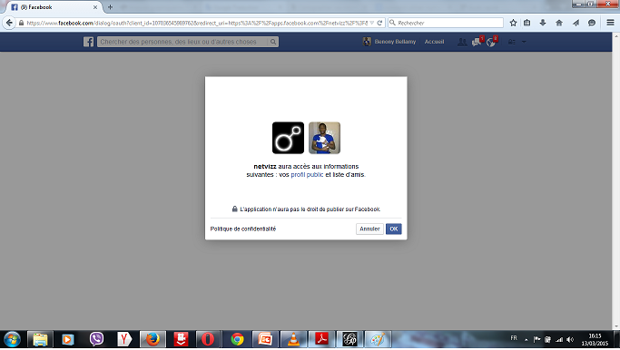
Using Gephi on facebook social network (Practical part)
Import data file
Above all, we must reap our facebook data.
To do this we have several applications on Facebook that allow us to export the data as .gdf files (Netvizz, netvizzpg, myfnetwork ...).
In this demonstration, we will use the Netvizz application that can allow us to import data types: group data, page like network, data page
Open facebook account you want to download information.
Enter the name of the application (Netvizz) in the search bar and run.
Validate permissions by clicking "OK”

Slide 50
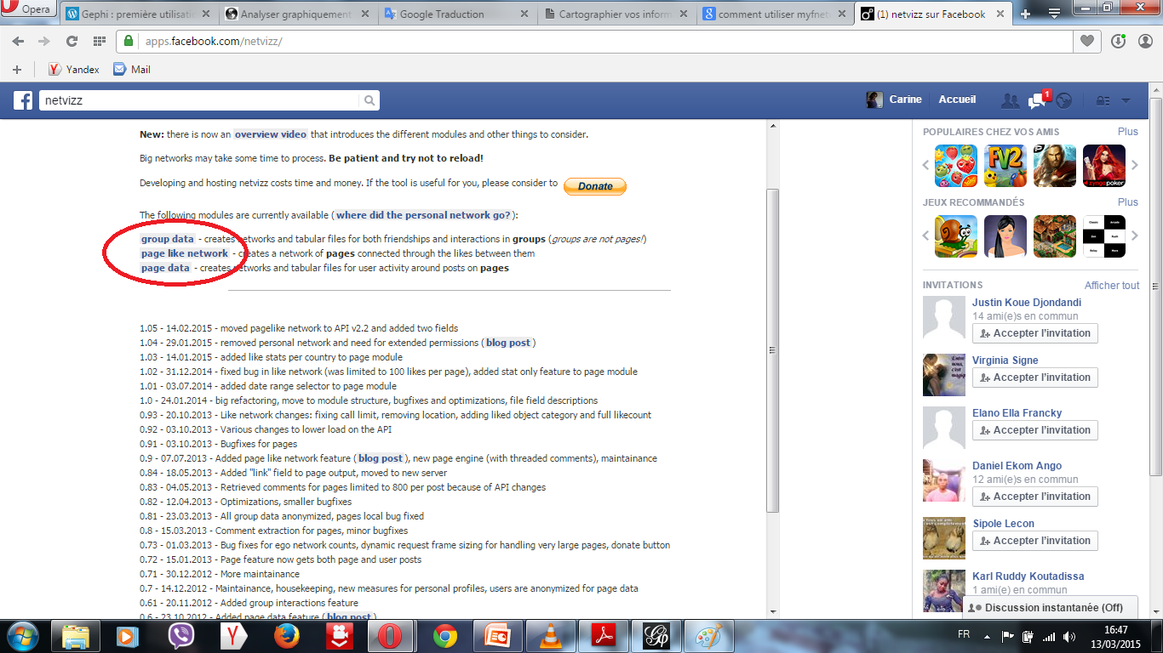
It is located on the facing page against
Then click on the link for the types of information you want to download

Slide 51
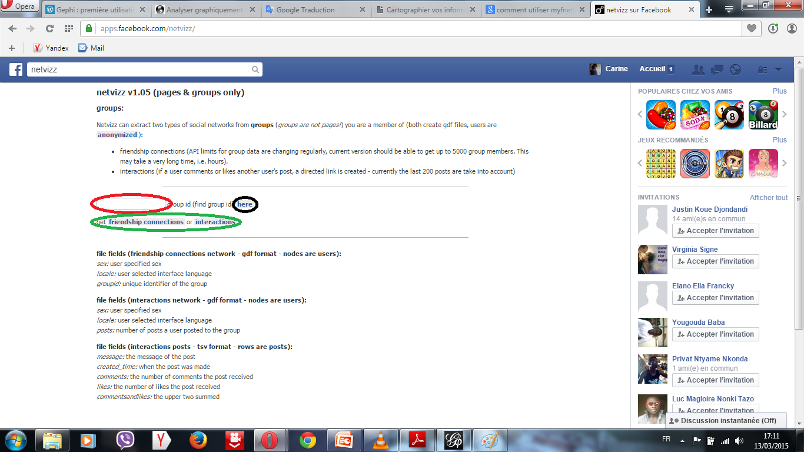
Click on the group data link, which leads to this page.
Enter the id of the group you want information.
Confirm by clicking the link friendship connections or
interactions.

Slide 52
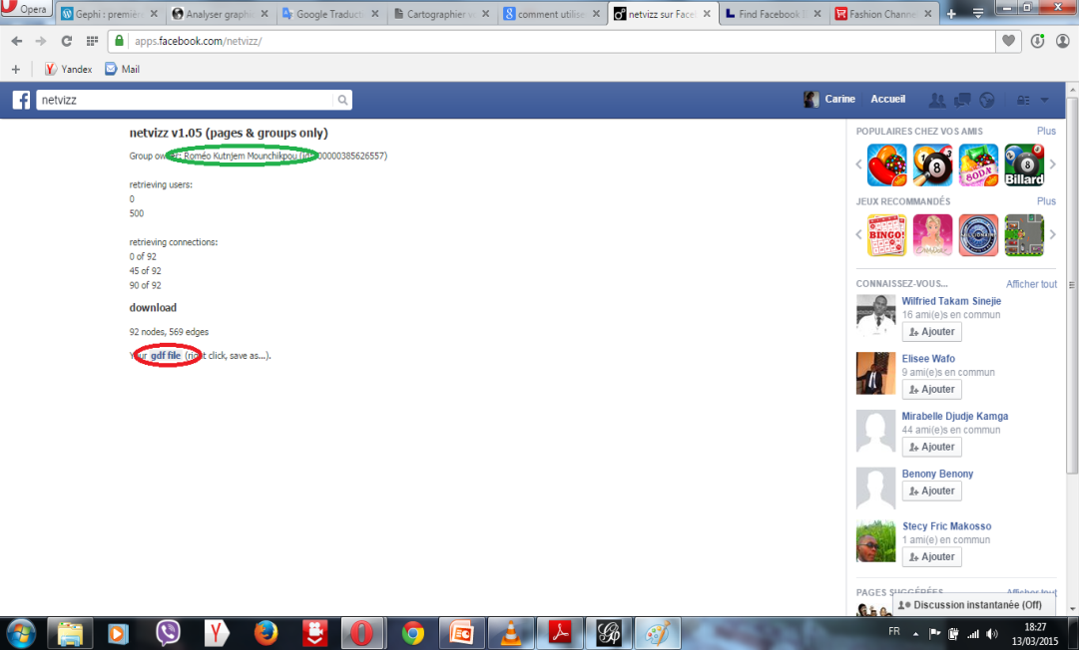
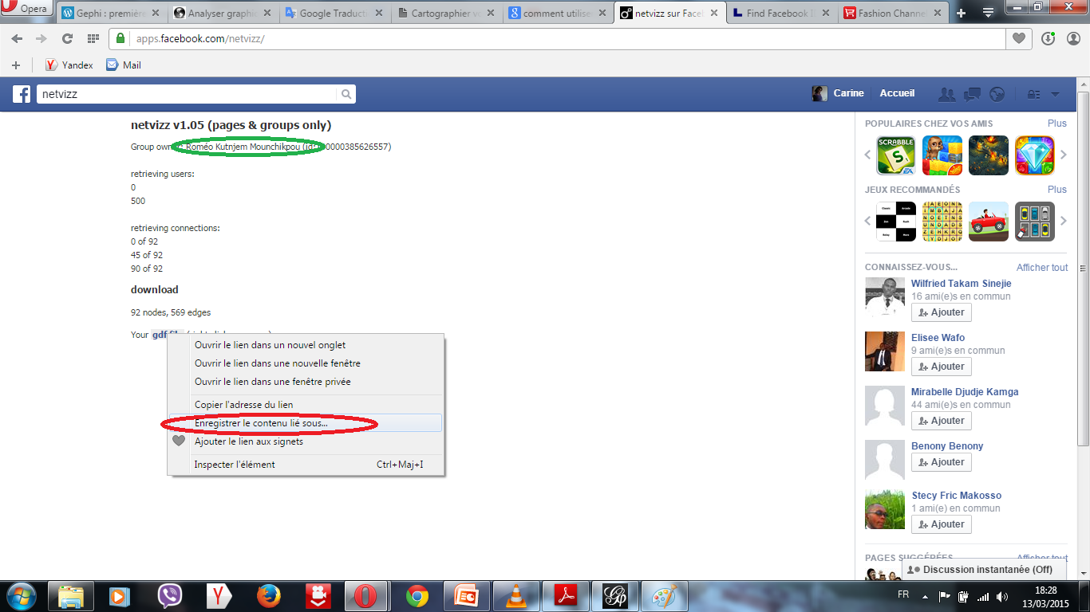
A loading page open, and depending on the number of people that can hold the group, it may take time to download the data.
At the end of the download, save .gdf file.

Slide 53
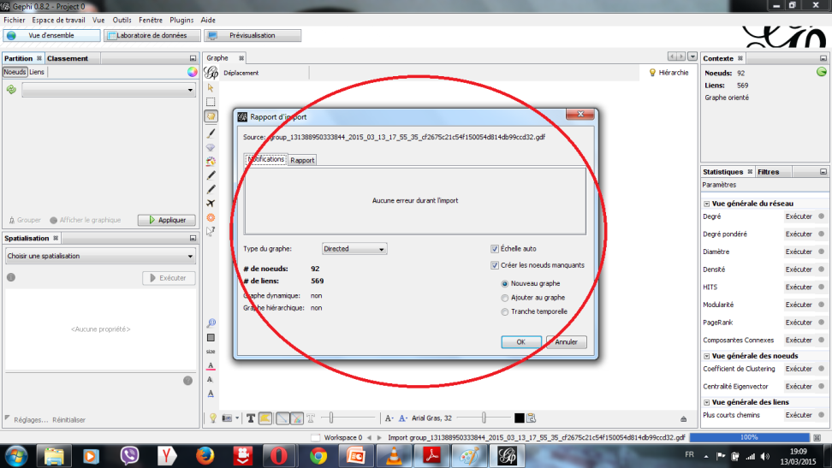
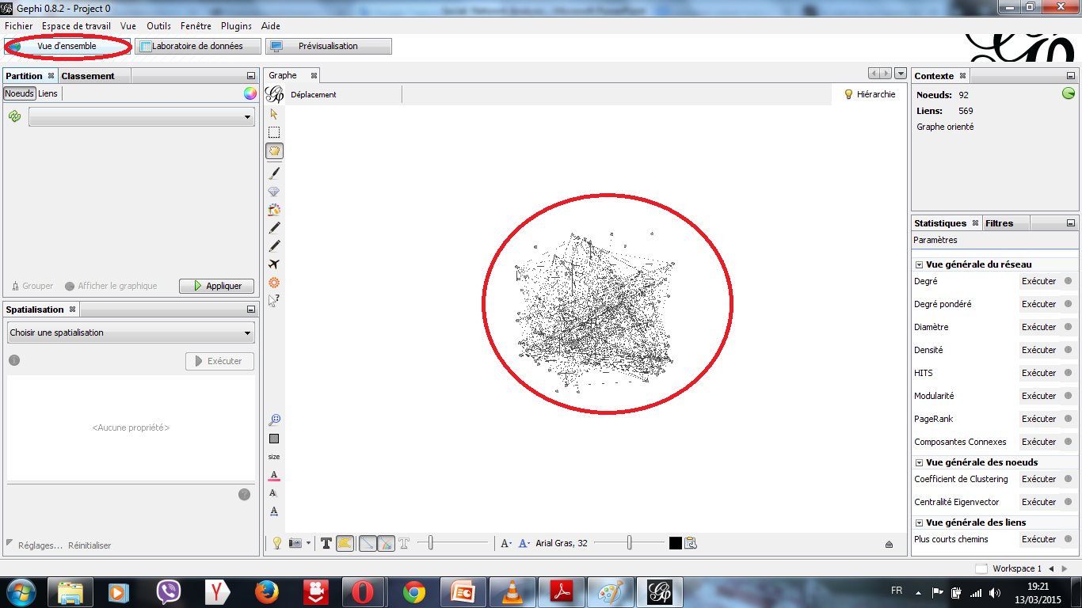
Mapping of data downloaded
Start Gephi
Go to File / New Project
Then File / Open: to open .gdf file download.
Click ‘ok’

Slide 54
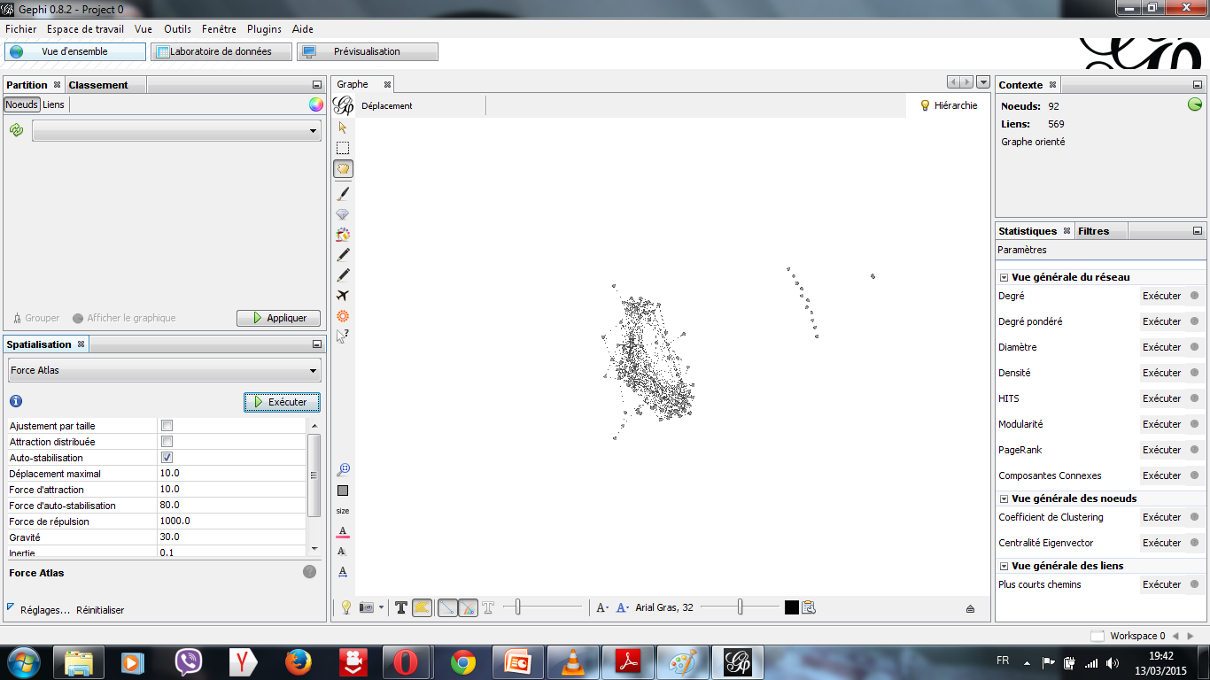
To better glimpse of our network, we will use a first algorithm: Force Atlas best suited for social networks. (If my network is large: Force Atlas 2 is better)
Select Force Atlas in the spatial tab and run. Do not forget to click "stop" when the network seems already stable.

Slide 55
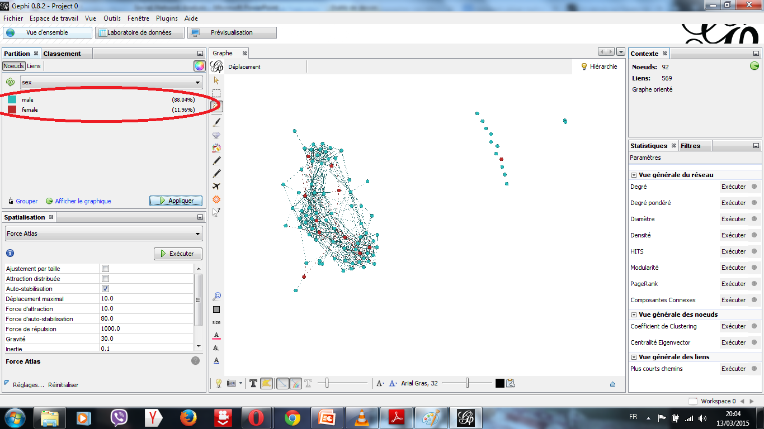
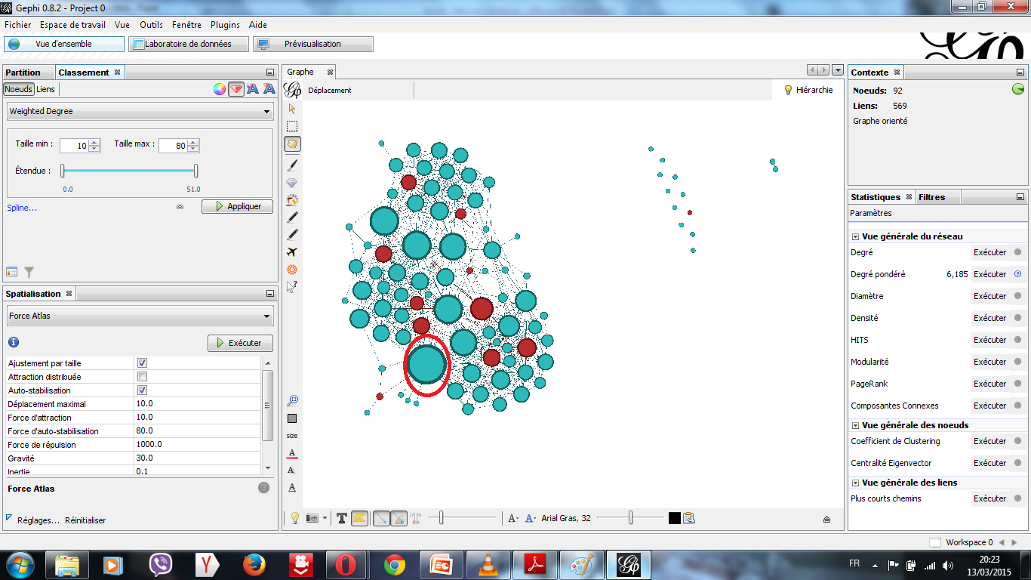
Now we will determine some information in our network:
The gender difference (male and female).
Go to the Partition tab / refresh / choose "sex" / execute.
The individual with the most relationships in the network.
Go to statistics tab and run weighted degree
Go to the ranking tab / select the size symbol / selects weighted degree / runs
Go to the spatial tab / select Force Atlas / check parameter "fit by size" and runs

Slide 56
Group network mapping with Gephi, analysis graphs and interpretation of the results obtained: Name of group: Computer After extractions information about the group by Netvizz, we have the Social Network, which size is the following: Nodes: 155 and Edges: 932 During the analysis of data obtained by Gephi (type of graph: directed) we obtained the following main graphs (figure 1-6):

Slide 57
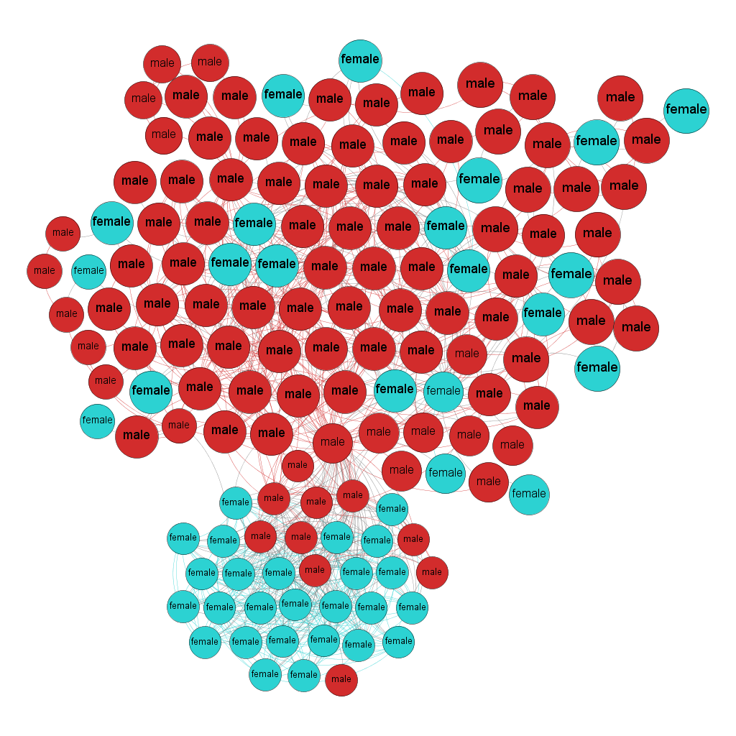
In this first graph the parameters were used: Algorithms Forces Atlas and labels adjustments, Statistical formulas modularity and sex partition
The filter of modularity of order 10(after filter we have: nodes: 145 and edges: 932).
Modularity: 0,463.
Gender partitions: 2 (male = 67.59, female= 32.41)
We use a Gender partition to determinate a percentage of girls in the network.
We can conclude that the analysis of social networks the "Computer" group consists of more boys than girls. And most of these girls are rather strongly connected to each other.
This verifies the fact that, since few girls choose to study computer science, then we will have fewer girls in a group of computer science.
Graph 1
The label in this graph is a Gender of members of group.

Slide 58
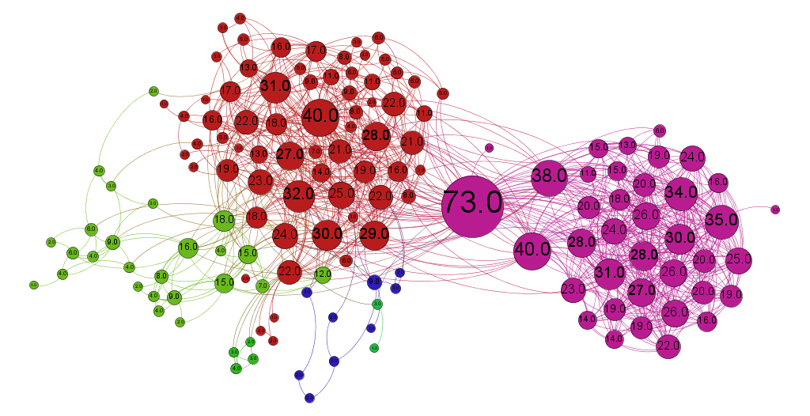
In this second graph the parameters were used: Algorithms Forces Atlas and labels adjustments, Statistical formulas weighted degree and modularity.
The filter of degree of order 1 to remove all individuals who not have more than one connection in the network
Weighted degree: 6,013.
Number of communities: 4
We can conclude that 3 clusters strongly interconnected: cluster of
Computer women arward (Girls of the computer science department who were or are doing in the developments and discoveries in information and communication technologies) (17.36 %);
Informatics developers club: students who share ideas on the development of computer applications (29.75 %);
Google revolution: Students who working and sharing on Google applications (46.28 %).
The individual with the most relationships in this group is the user with degree = 73 relationships (Nodes largest of the graph).This user is a student who created the group “Computer”.
Graph 2
The label in this graph is a degree.

Slide 59
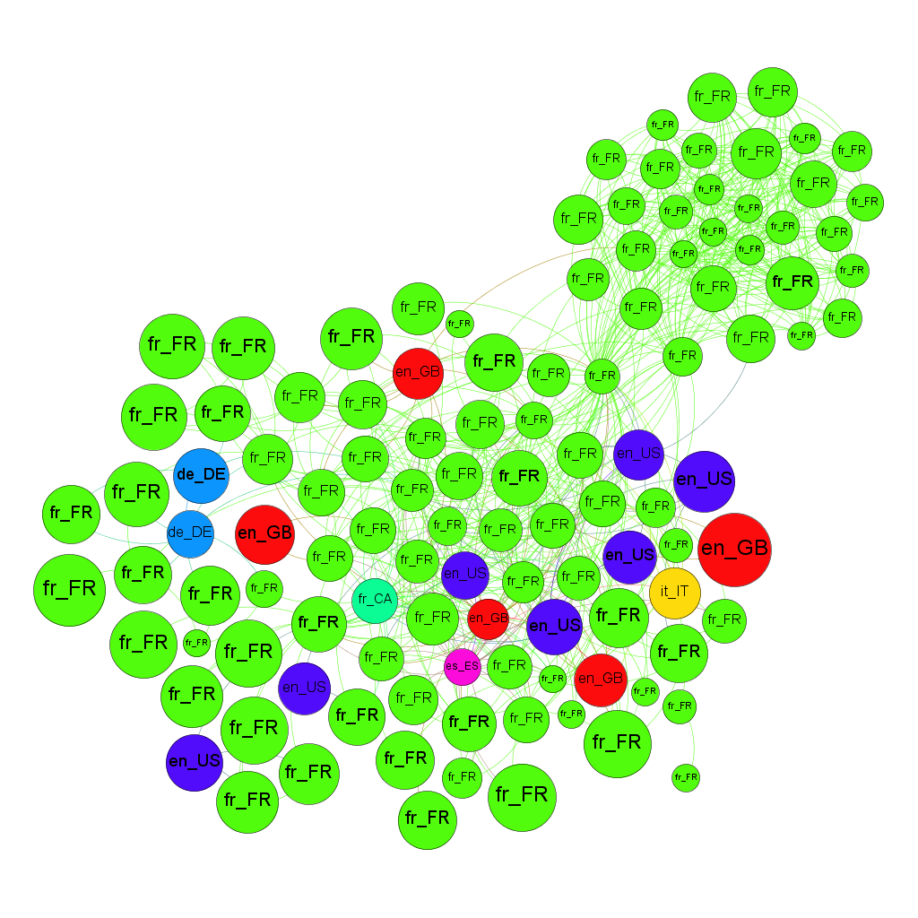
In this third graph, the parameters were used: Algorithms Forces Atlas and labels adjustments, Statistical formulas diameter (closeness centrality) and locale partition.
The filter of closeness centrality of order 0.1 to remove all individuals who have a maximum distance of 0.1 with other individuals and we use a locale partition to know which how many languages is used in this group.
Diameter: 5
Modularity: 0,463
Number of languages: 7
We can conclude that Network students speaking with seven different languages (French of France = 85, 22%, English of USA = 6, 09%, English of England = 4, 35%, German of Germany = 1, 74%, Spanish of Spain = 0, 87%, French of Canada = 0,87% and Italian of Italy = 0,87% ).
Graph 3
The label in this graph is a language of members of group.

Slide 60
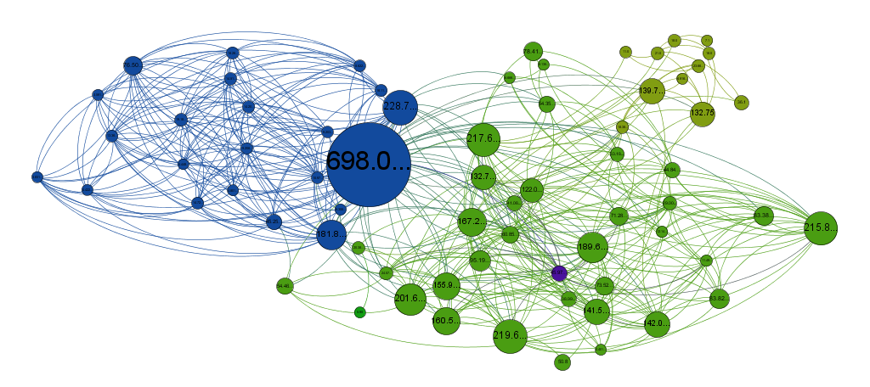
In this fourth graph, the parameters were used: Algorithms Forces Atlas and labels adjustments, Statistical formulas diameter (betweenness centrality) and modularity
The filter of betweenness centrality of order 3.5 to remove all individuals that the percentage of appearance in the shortest path between two individuals is 3.5 maximum
Diameter: 5
Betweenness centrality min: 0.0
Betweenness centrality max: 698.0
Modularity: 0,463
Number of communities: 3
The individual with the highest frequency of occurrence of the shortest paths between two individuals keep is the user with betweenness centrality = 698.0 . This user is a student who created the group “Computer”.
Graph 4
The label in this graph is a Betweenness centrality of members of group.

Slide 61
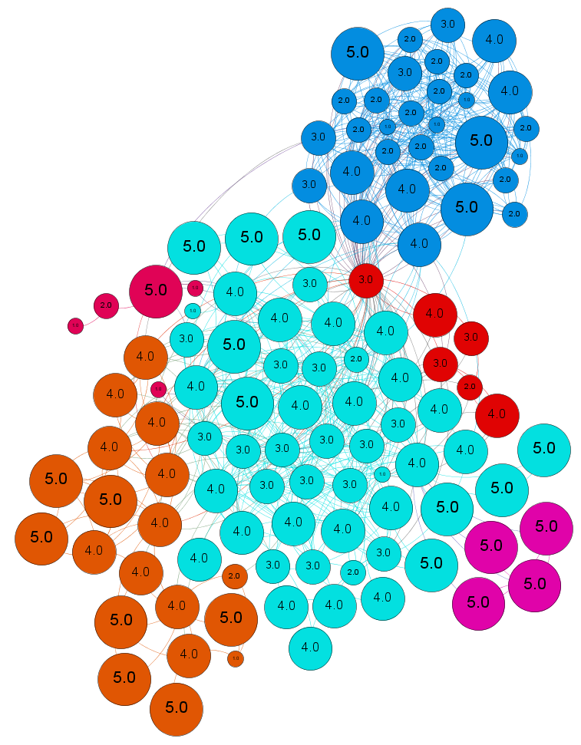
In this fifth graph, the parameters were used: Algorithms Forces Atlas and labels adjustments, Statistical formulas diameter (eccentricity) and modularity
The filter of eccentricity of order 0.51 to remove all individuals who have a maximum distance of 0.51 with the most distant individuals.
Diameter: 5
Eccentricity min : 0.0
Eccentricity max: 5.0
Modularity: 0,463
Number of communities: 6
In this graph, over the node is bigger, the individual is away from the other members of network.
Graph 5
The label in this graph is a Eccentricity of members of group.

Slide 62
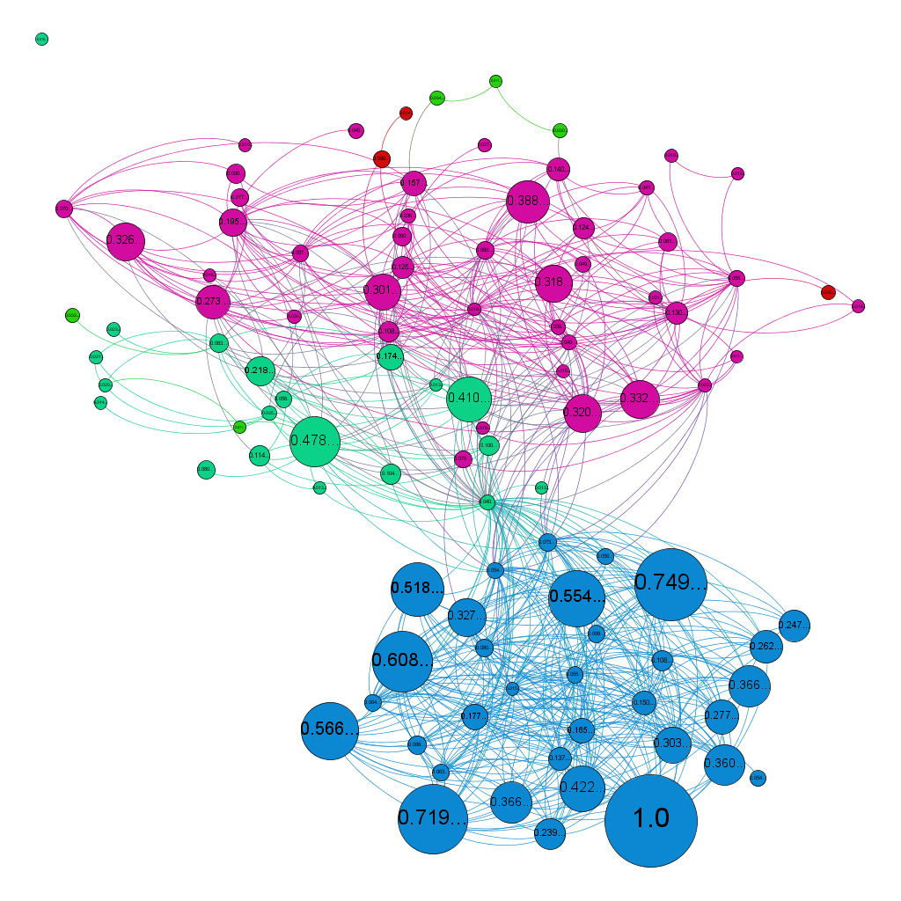
In this sixth graph, the parameters were used: Algorithms Forces Atlas and labels adjustments, Statistical formulas Eigenvector centrality and modularity
The filter of Eigenvector centrality of order 0.01 to remove all individuals who have an importance of 1% in the network.
Number of iterations: 100
Eigenvector centrality min: 0.0
Eigenvector centrality max: 1.0
Modularity: 0,463
Number of communities: 4
The individual with the most importance in the network is user with Eigenvector centrality = 1
Graph 6
The label in this graph is a Eigenvector centrality of members of group.

Slide 63
The SNA is a useful and effective instrument for revealing the main specificity of the human's relationships of the social groups;
Software Gephi is the applicable tool for visualizing revealed people's interactions peculiarities and the relational dimension of the communities inside the social groups.

Slide 64
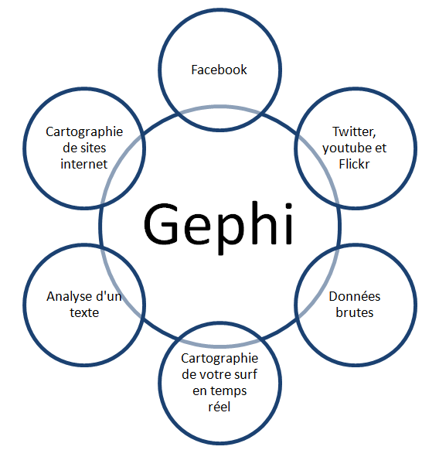
Where we can also use Gephi
Apart from the analysis of social networks (facebook, twitter, youtube, ...) , Gephi is an application that can also be used for other purposes, with many other types of data:
Raw data,
Mapping a network,
Analysis of a text,
Mapping a real-time surfing,
……
It is also used in several areas of life (biological analysis, geographic analysis, business analysis, pedigree analysis, ...)

